Slide 1




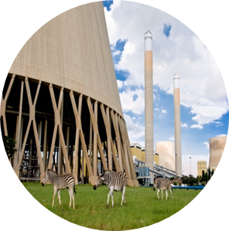

Tutorial E T-pipe junction Transient Thermomechanical FEM model 2
By Ofentse Kgoa
kgoaot@eskom.co.za

Slide 2
Introduction
Background:
It is assumed that Tutorial B and C is completed.
Objectives:
Open an existing FreeCAD project
Prepare CAD geometry for FEM modeling
Run a transient thermomechanical FEM model
Evaluate and analyze the thermomechanical FEM results
Create a result set vs. time plot
Save the FreeCAD project

Slide 3
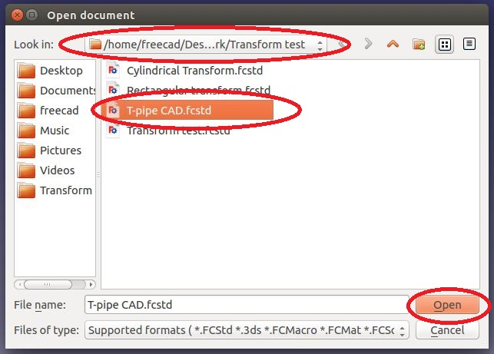
Project start Up
Open an existing project:
To open an existing project, click on <Open a document or import files>
A task dialogue appears, choose the directory the file directory, select the project to be opened and then click on <Open>

Slide 4
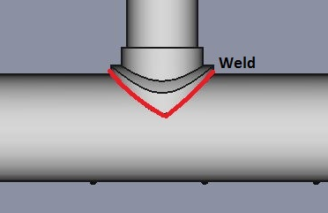
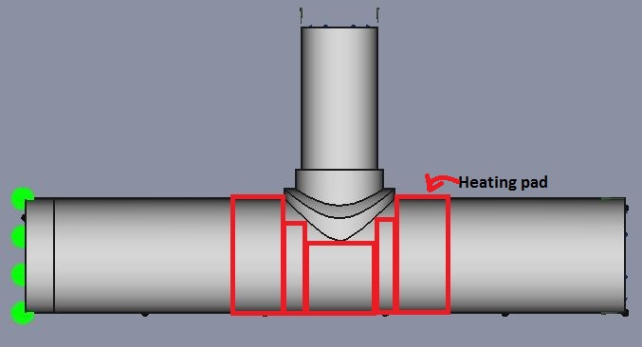
Thermomechanical FEM model (Transient 2) Pre- processing
Notes and assumptions:
This transient analysis models the heating of a weld by a heating pad to a heat treatment temperature of 980 K.
Due to the geometry of the reinforcement, heating pads cannot be placed directly on the weld as indicated in the picture.
There will be thermal contact resistance between the heating pad and T-pipe. To simulate this a heat flux will be applied to the heat treatment area.

Slide 5
Thermomechanical FEM model (Transient 2) Pre- processing
Notes and assumptions:
The are numerous factors that affect the thermal conductance (film coefficient) between two surfaces in contact. These include the surface roughness of the materials, the material pair and the contact between the material pair.
The film coefficient to be used for this contact is 500 W/m²K which is an estimate of the thermal conductance between a typical heating pad and steel pipe.
More accurate values of the thermal conductance between different material pairs can be obtained from literature.

Slide 6
Thermomechanical FEM model (Transient 2) Pre- processing
Notes and assumptions:
Air at room conditions is the fluid inside the T-pipe junction.
The T-pipe junction is insulated on the external surfaces that are not part of the heat treatment area.
The internal surface of the pipe is not exposed to an internal pressure and therefore the end cap is not necessary in this analysis.
The time it takes for the weld to reach 980 K is to be investigated.
The maximum temperature difference over time is to be plotted and investigated.
Stresses over time are to be plotted and investigated.

Slide 7
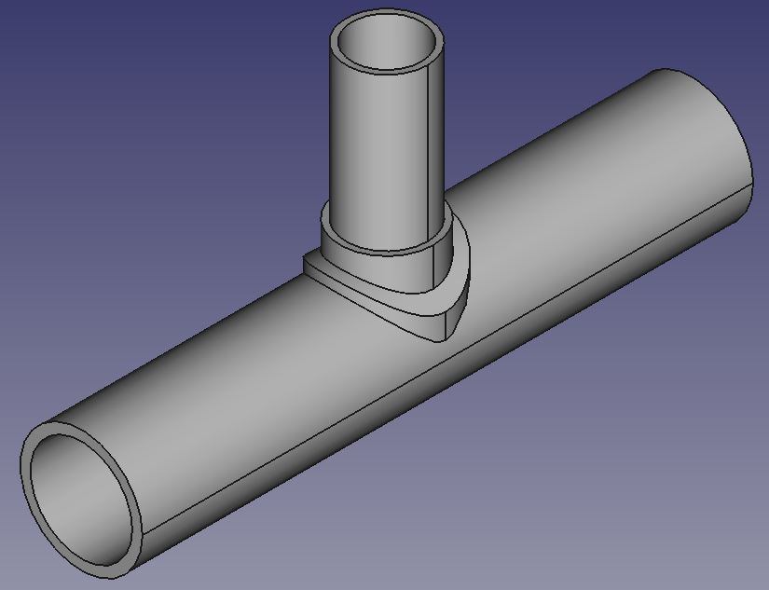
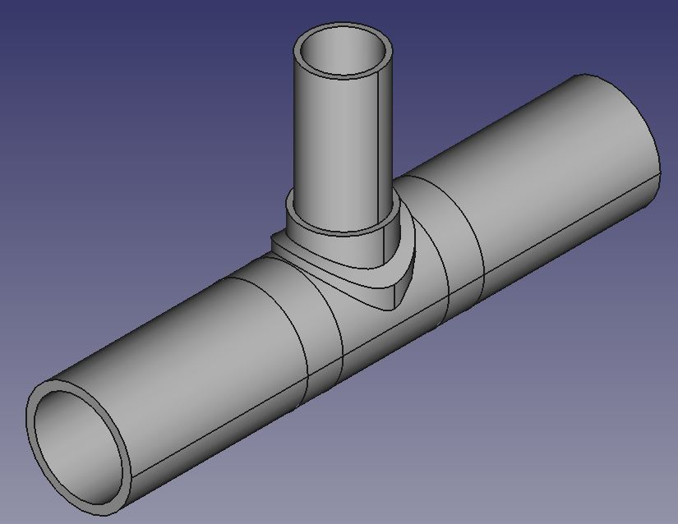
Thermomechanical FEM model (Transient 2) Pre- processing
Preparing the geometry:
The shell pipe needs to be cut to create selectable surfaces on which the heating pad will be placed.
Create two cylinders of radius 150 mm and length 100 mm. Rotate these cylinders 90° about the X-axis as indicated in the picture. The cylinders should be translated -150 mm and 250 mm in the Y direction respectively.
Join these two cylinders to the T-pipe junction.

Slide 8
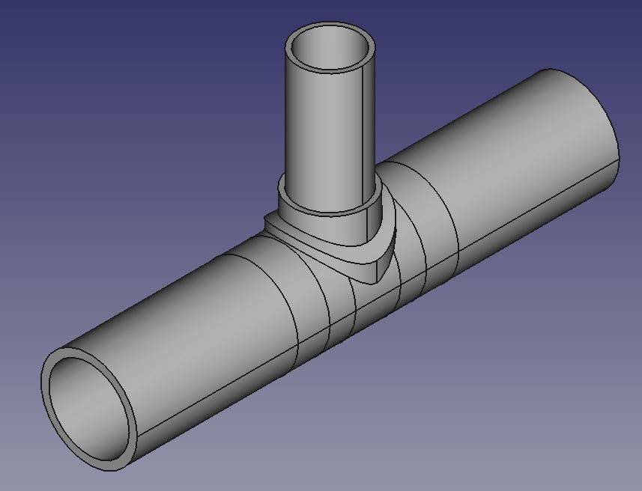
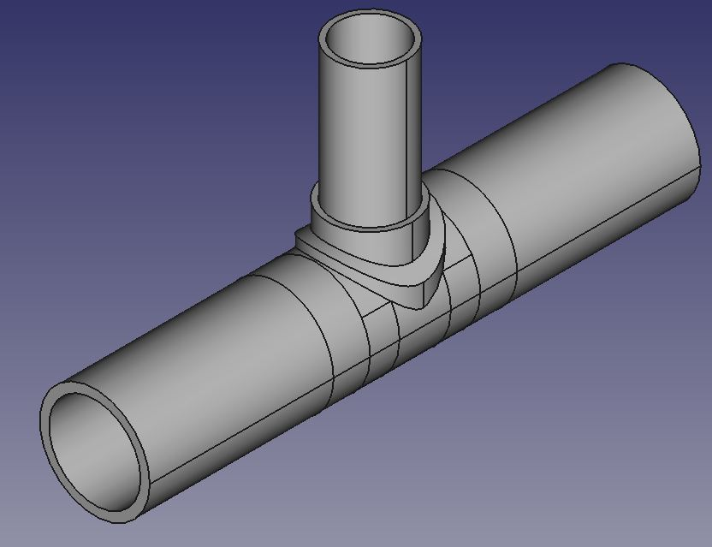
Thermomechanical FEM model (Transient 2) Pre- processing
Preparing the geometry:
Create another two cylinders of radius 150 mm and length 80 mm. Rotate these cylinders 90° about the X-axis as indicated in the picture. The cylinders should be translated --70 mm and 150 mm in the Y direction respectively. The geometry should be similar to that displayed in the picture.
Create a cube with length, width and height of 500 mm, 500 mm and 300 mm respectively. Translate the cube -250 mm, -250 mm and 80 mm in the X, Y and Z respectively.
Use this cube to cut the two cylinders created as indicated in the picture. Join the two cylinders to the T-pipe junction.

Slide 9
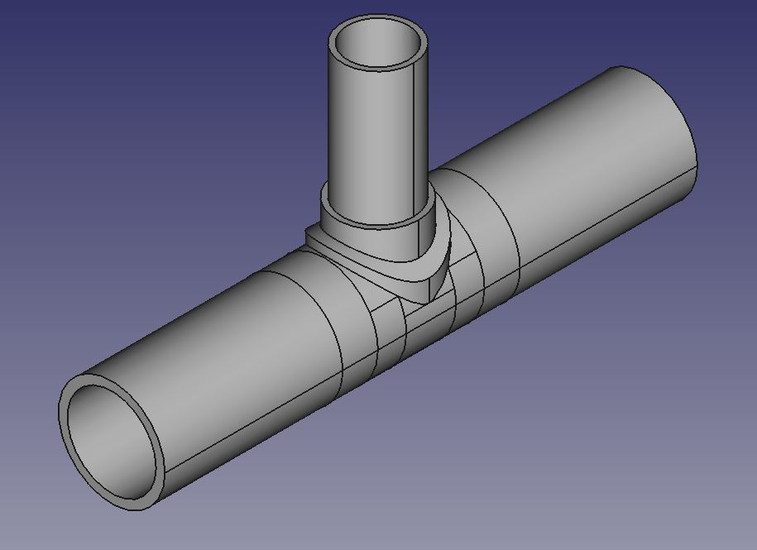
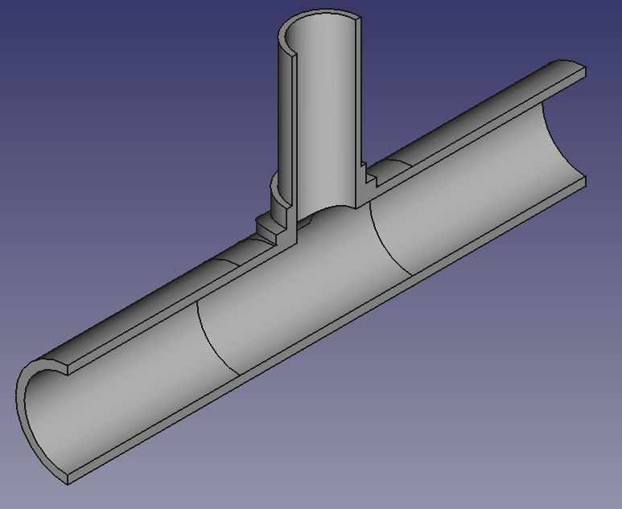
Thermomechanical FEM model (Transient 2) Pre- processing
Preparing the geometry:
Create a cylinder of radius 150 mm and length 140 mm. Rotate the cylinder 90° about the X-axis.
Create a cube with length, width and height of 500 mm, 500 mm and 300 mm respectively. Translate the cube -250 mm, -250 mm and 38 mm in the X, Y and Z respectively.
Use the cube to cut the cylinder created. Join all the parts together. The geometry should be similar to the geometry in the picture.
The branch pipe needs to bored with a cylinder of radius 125 mm and the entire T-pipe needs to be cut in half. The final geometry is indicated in the picture.

Slide 10
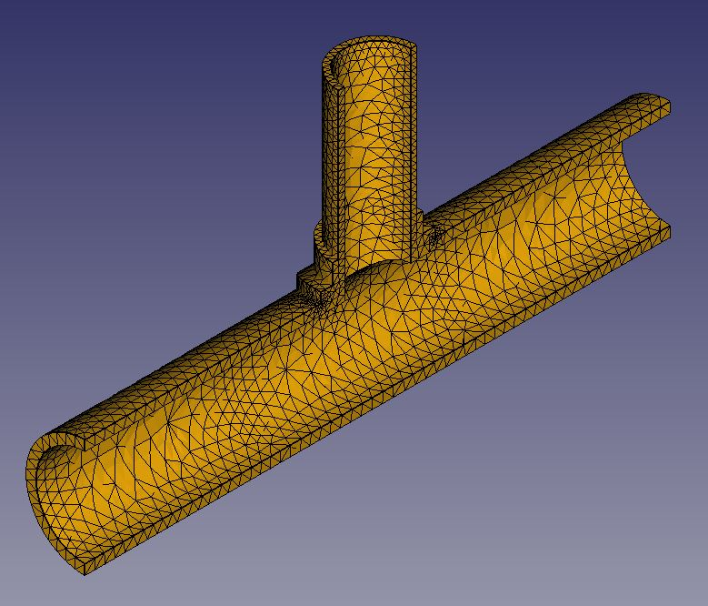
Thermomechanical FEM model (Transient 2) Pre- processing
Creating the Mesh:
For all FEM models, a mesh needs to be created.
Refer to Tutorial B which shows how to create a mesh.
The material to be used in the analysis is “Steel-Generic”.
Refer to Tutorial B on how to specify a material.
Material specification:

Slide 11
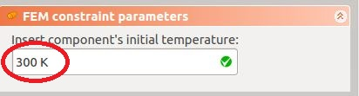
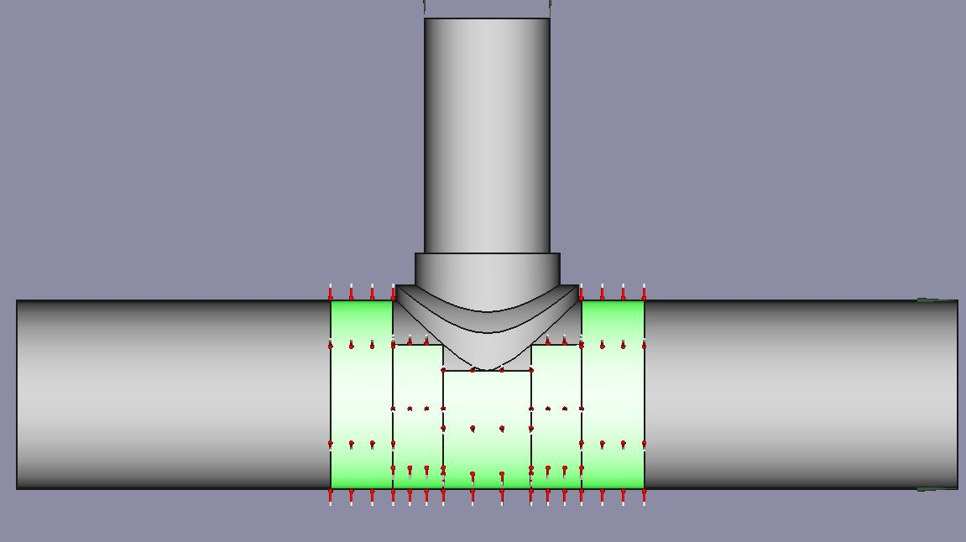
Thermomechanical FEM model (Transient 2) Pre- processing
Boundary conditions:
The T-pipe needs to fixed in the X, Y and Z directions. To do this use the displacement constraint. Refer to Tutorial B for more information.
Apply an initial temperature of 300 K to the entire T-pipe junction.
Add a heat flux constraint on all areas apart from the heat treatment area. The ambient temperature should be 980 K and the Film coefficient should be 500 W/m²K.

Slide 12
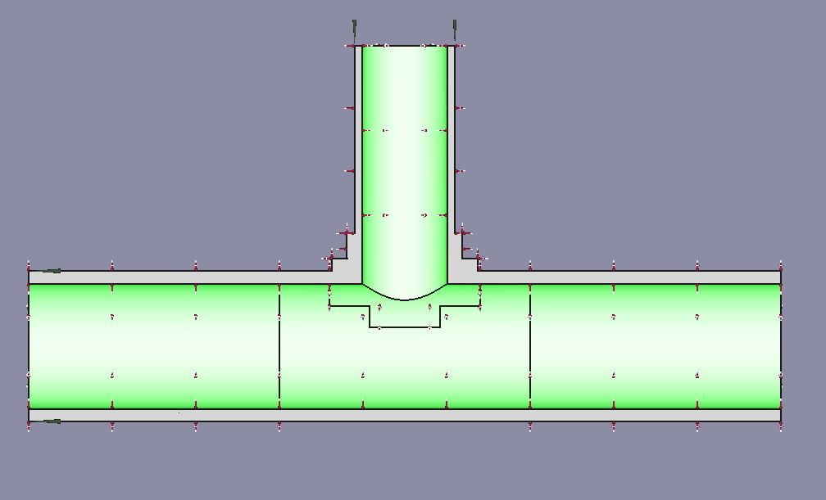
Thermomechanical FEM model (Transient 2) Pre- processing
Boundary conditions:
Add a heat flux constraint on the internal surface of the T-pipe. The ambient temperature should be 300 K and the Film coefficient should be 10 W/m²K.
Select all the faces indicated in the picture for the heat flux constraint.

Slide 13
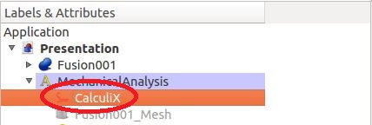
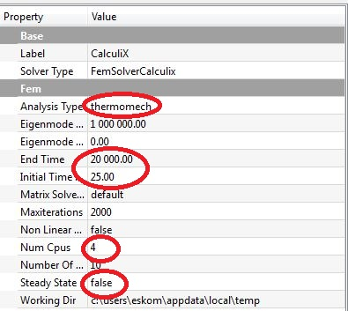
Thermomechanical FEM model (Transient 2) Running the Solver
Running the Analysis:
The analysis to be run is a transient thermomechanical analysis.
Click on CalculiX in the object tree view. In the property window, the user has different FEM solver settings. Change the “End Time” to 20000 time steps and select “false” under “Steady State”.
The larger the number of time steps the longer the computing time.
Choose an Initial Time Step of 25. This value is chosen to reduce the computing time, but it should be chosen with caution as it may affect the accuracy of the results.

Slide 14
Thermomechanical FEM model (Transient 2) Running the Solver
Running the Analysis:
The user can also select the number of cpus/cores that should be used by the solver. Enter the number of cpus that are less than or equal to the cpus available from your computer. For instance if the users computer has 6 cpus, the user should choose up to 6 or less cpus.
Now double click on the CalculiX object in the object tree view and run the analysis.

Slide 15
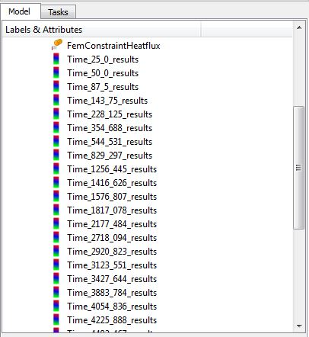
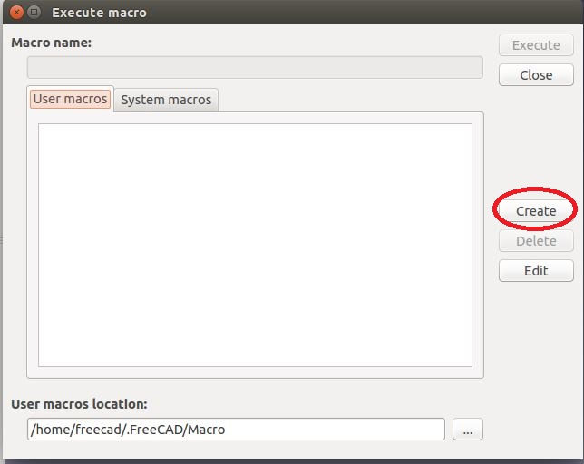
Thermomechanical FEM model (Transient 2) Post-processing
Creating a result set vs. time plot:
A transient analysis produces results for different time steps. The user can view results at any certain time step.
It is impractical to view results at each time step for analysis of the transient period of the T-pipe. A solution is to plot results over time.
To plot results click on <Open dialogue to the execute a recorded macro>.
A task dialogue appears, click on <Create>.
The name of the macro should be “Max Temp Diff”

Slide 16
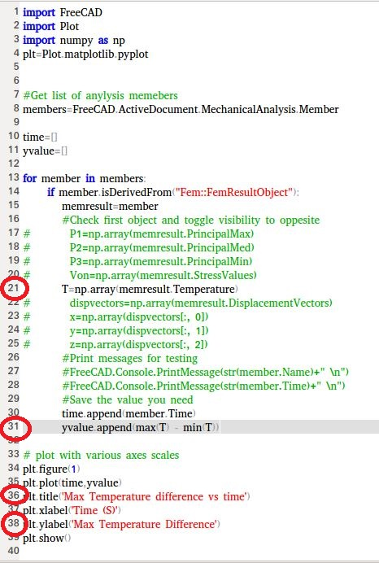
Thermomechanical FEM model (Transient 2) Post-processing
Creating a result set vs. time plot:
An empty macro script appears. Type in the python code displayed in the picture. Ensure that the spacing is the same as that displayed in the picture.
The python code plots the max temperature difference against time.
It is important to note that python coding is case sensitive as well as space sensitive. Meaning that if the is a space where it should not be, the code will not work.
Save the macro.

Slide 17
Thermomechanical FEM model (Transient 2) Post-processing
Creating a result set vs. time plot:
Now create another macro and call it “Max stress”. Use the same python code displayed in the picture.
Remove the “#” on line 20 and add a “#” on line 21. Line 31 should also be changed to plot “Max Von”.
Change the plot titles on lines 36 and 38 accordingly.
Save the macro.

Slide 18
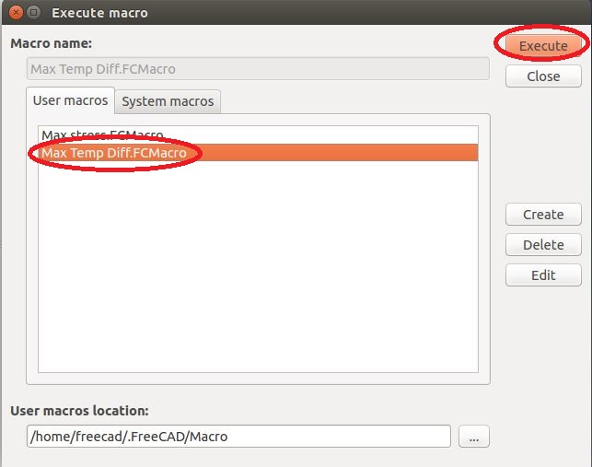
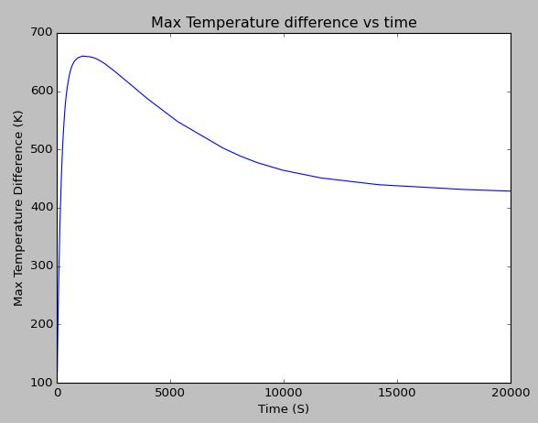
Thermomechanical FEM model (Transient 2) Post-processing
Creating a result set vs. time plot:
Execute the “Max Temp Diff” macro to plot max temperature difference experienced by the T-pipe junction against time.
To plot click on <Open dialogue to the execute a recorded macro>. Select the “Max Temp Diff” macro and click <Execute>.
The plot is depicted in the picture.

Slide 19
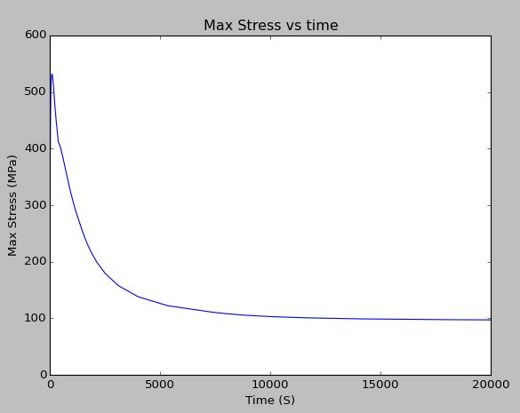
Thermomechanical FEM model (Transient 2) Post-processing
Creating a result set vs. time plot:
Execute the “Max Stress” macro to plot max von mises stress experienced by the T-pipe junction against time.
The plot is depicted in the picture.

Slide 20
Thermomechanical FEM model (Transient 2) Post-processing
Analyzing the results:
From the max temperature difference plot, it can be seen that the highest temperature gradient of 660 K occurs after the first 1000 seconds.
The time step at 1000 seconds is to be investigated due to the fact that the stress at this time is above the proof stress of 175 MPa of the material. (refer to tutorial B for information regarding the proof stress)

Slide 21
Thermomechanical FEM model (Transient 2) Post-processing
Analyzing the results:
From the max stress plot, it can be seen that the highest von mises stress of 540 MPa occurs after the first 100 seconds.
The time step at 100 seconds is also to be investigated.
The system reaches steady state after 20000 seconds. The maximum stress experienced by the T-pipe after reaching steady state is 100 MPa.

Slide 22
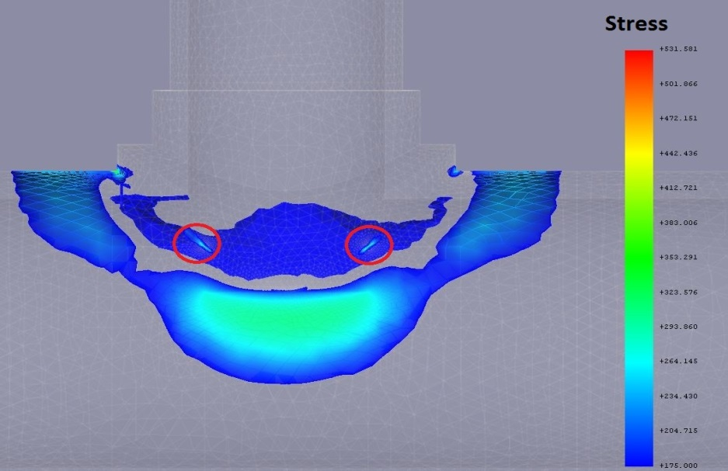
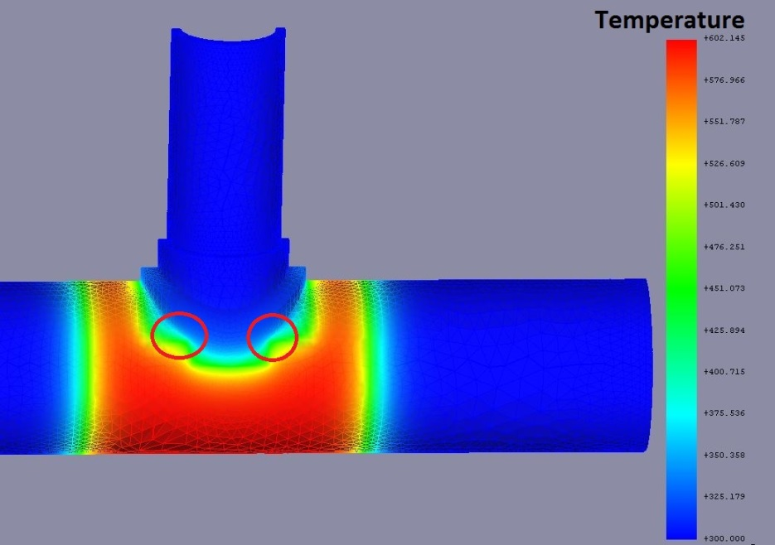
Thermomechanical FEM model (Transient 2) Post-processing
Analyzing the results:
The location of the maximum stress needs to be investigated. Go to the result set at time step 100 and create a post processing scalar clip pipeline to investigate areas in the T-pipe that experience stresses above the proof stress of 175 MPa.
Also create a post processing pipeline for temperature.
The region that experiences high stresses is circled in the stress picture. It can be seen that this region experiences the high stresses due to the fact that it has a different temperature than the areas around it. Furthermore it is at a location of stress concentration due to the change in geometry.

Slide 23
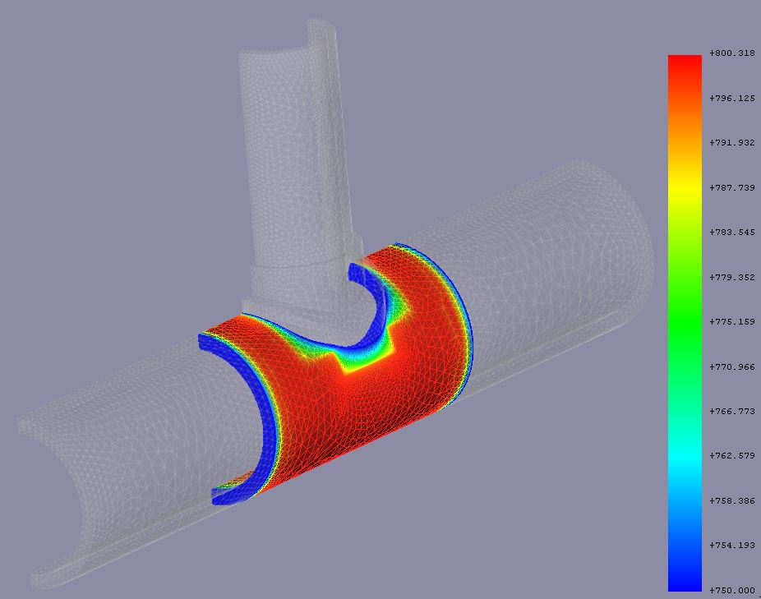
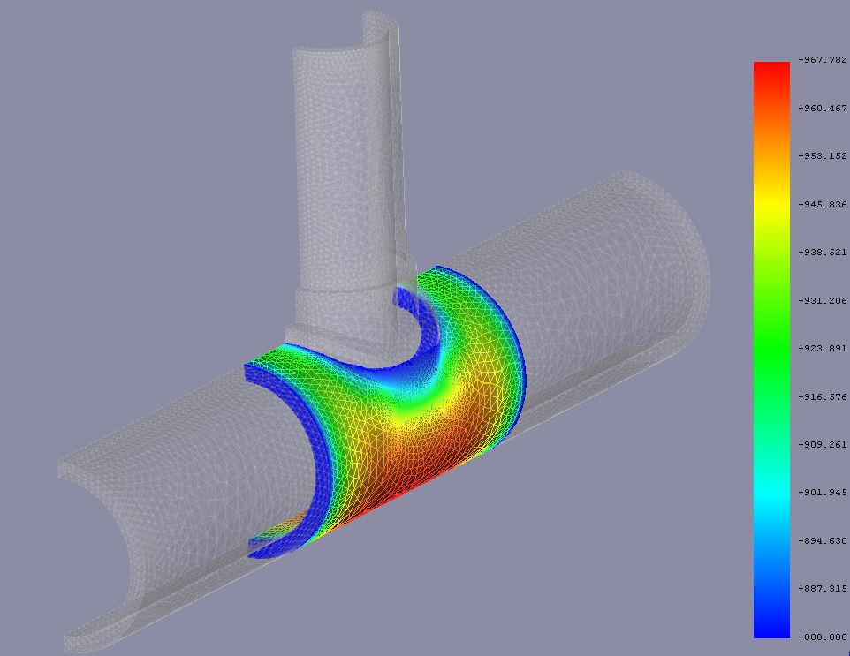
Thermomechanical FEM model (Transient 2) Post-processing
Analyzing the results:
The steady state temperature at the weld region needs to be investigated to check whether or not the weld reaches the heat treatment temperature of 980 K.
Go to the last time step and create a post processing scalar clip pipeline of 880 K for temperature.
From the scalar clip it can be seen that the weld reaches a temperature just over 880 K which is less than the target heat treatment temperature. It can also be seen that the weld does not experience a uniform temperature across it throughout the entire heat treatment process.

Slide 24
Thermomechanical FEM model (Transient 2) Post-processing
Concluding remarks:
In order to reduce the temperature gradient experienced by the T-pipe during the heat treatment process the heating pad temperature needs to be ramped up slowly to the heat treatment temperature K.
It can also be concluded that the manner in which the heating pads were placed on the T-pipe is not very efficient in getting the weld to a uniform temperature of 980 K. Furthermore it causes a temperature gradient across the weld that causes high stresses in the weld which are amplified by the fact that the weld is at a location of stress concentration.

Slide 25
Thermomechanical FEM model (Transient 2) Post-processing
Concluding remarks:
Furthermore the heat treatment process requires +330 minutes to reach steady state, the heat treatment process of the T-pipe should be planned accordingly in line with this time.

Slide 26

END

